Slide 1
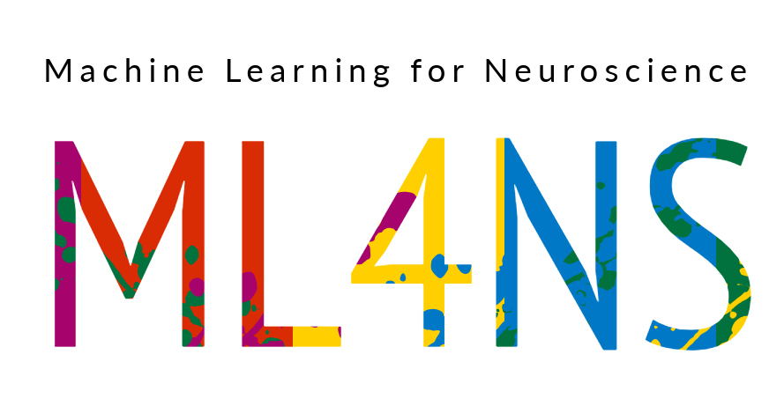
Ethical Considerations and Responsible Machine Learning
Payam Barnaghi
Department of Brain Sciences &
School of Convergence Science in Human and Artificial Intelligence
Imperial College London
January 2025
Notes:
1

Slide 2
Machine learning for healthcare and medicine
The ultimate goal of developing machine learning models and systems in healthcare is deploying them in real-world settings and using them to improve patient and healthcare outcomes.

Slide 3

ML deployments in real-world settings
The systems are often used for decision-support and have human-in-the-loop.
However, the trustworthiness, reliability, and robustness of the systems/models must be considered and investigated prior to deployment.
The users’ perceptions of the system and appropriate training should also be considered.

Slide 4

Offline and online models
Some models are designed to process offline and pre-collected datasets and can provide exploratory analysis and insights into the contributing factors to a disease, clusters and groups of features or patients based on different fractures.
Online models are trained based on some existing data and deployed in operational settings. Sometimes, their parameters are fixed, and sometimes, they are either periodically re-trained or learned as new data emerges (i.e. online or continual learning).

Slide 5
Continual learning
“Modern machine learning excels at training powerful models from fixed datasets and stationary environments, often exceeding human-level ability.”
“Yet, these models fail to emulate the process of human learning, which is efficient, robust, and able to learn incrementally, from sequential experience in a non-stationary world.”
Source: R. Hadsell et al., Embracing Change: Continual Learning in Deep Neural Networks,
Trends in Cognitive Sciences, December 2020, Vol. 24, No. 12.

Slide 6
Why do we need continual learning?
In continual learning, the model repeatedly receives new data, and the training data is not complete at a fixed given time.
If we re-train the entire model whenever there are new instances, it would be inefficient, and we have to store the trained samples.
The key challenge of continual learning scenarios in changing environments is how to incrementally and continually learn new tasks without forgetting the previous or creating highly complex models that may require accessing the entire training data.

Slide 7
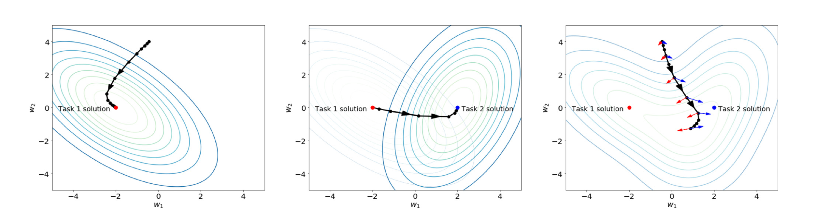

Continual learning
Source: R. Hadsell et al., Embracing Change: Continual Learning in Deep Neural Networks,
Trends in Cognitive Sciences, December 2020, Vol. 24, No. 12.

Slide 8
Forgetting problem in machine learning models
Most of the common deep learning models cannot adapt to different tasks without forgetting what they have learned in the past.
Updating and altering tasks of an already learned model leads to the loss of previously learned knowledge as the network is not able to maintain the important weights for various distributions.
The attempt to sequentially or continuously learn and adapt to various distributions will eventually result in a model collapse. This phenomenon is referred as catastrophic forgetting or interference (McCloskey et al., 1989) (Goodfellow et al., 2013).

Slide 9
Developing clinically and/or care applicable solutions
Before designing any model, the dataset should be thoroughly investigated, and the collection setting/condition, noise, bias, imbalance and suitability of the dataset for the planned analysis should be carefully considered.
We should investigate how and when the data is collected, how and when it will be used, and for what purpose.

Slide 10

Knowing your data
Before designing any model, the dataset should be thoroughly investigated, and the collection setting/condition, noise, bias, imbalance and suitability of the dataset for the planned analysis should be carefully considered.
It should be investigated how and when the data is collected, how and when it will be used, and for what purpose.

Slide 11
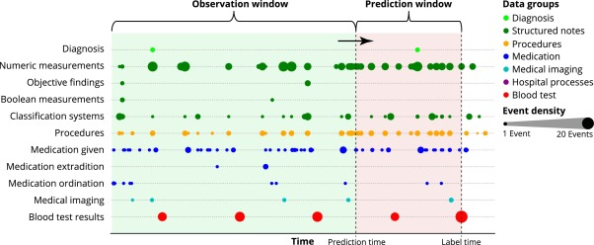
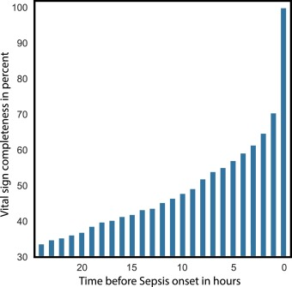
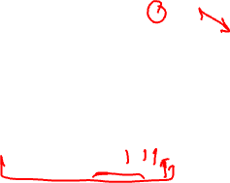
Outcomes and end-points
The clinical and care endpoints should be clearly defined.
For example, if the model is going to be used for the prediction of an adverse health condition in a hospital setting, what timeframe would be clinically useful for the model to make the predictions? i.e., predicting a specific condition a few minutes before it happens may not be as useful in a real-world setting.
Example:
Image source: S. Meyer Lauritsen et al., Early detection of sepsis utilizing deep learning on electronic health record event sequences, Artificial Intelligence in Medicine, 2020.

Slide 12
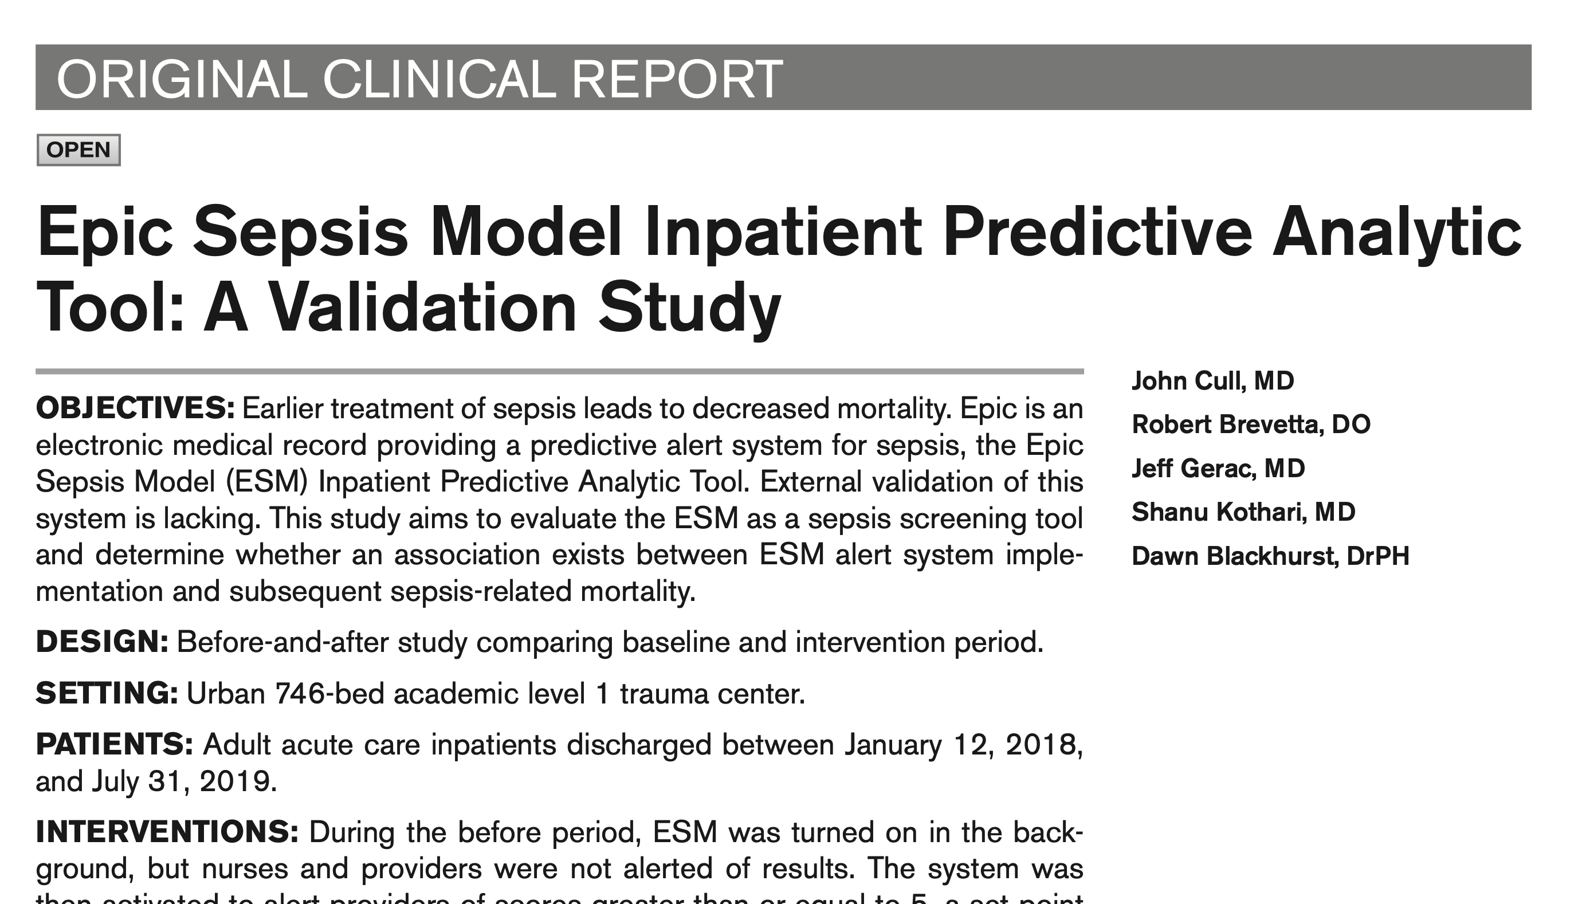
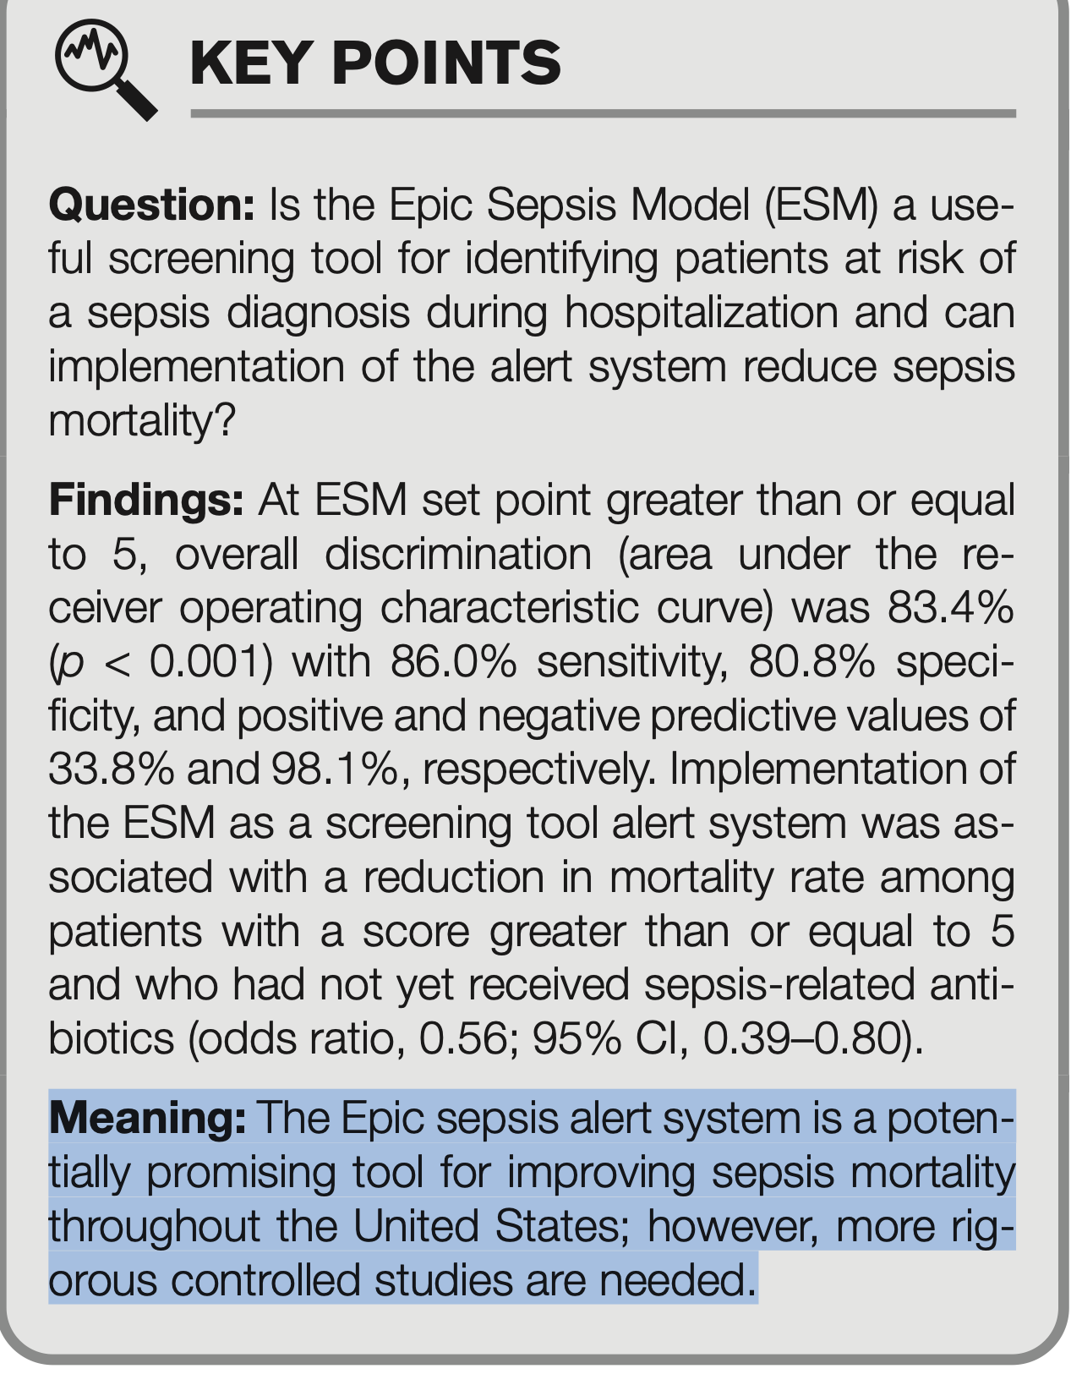
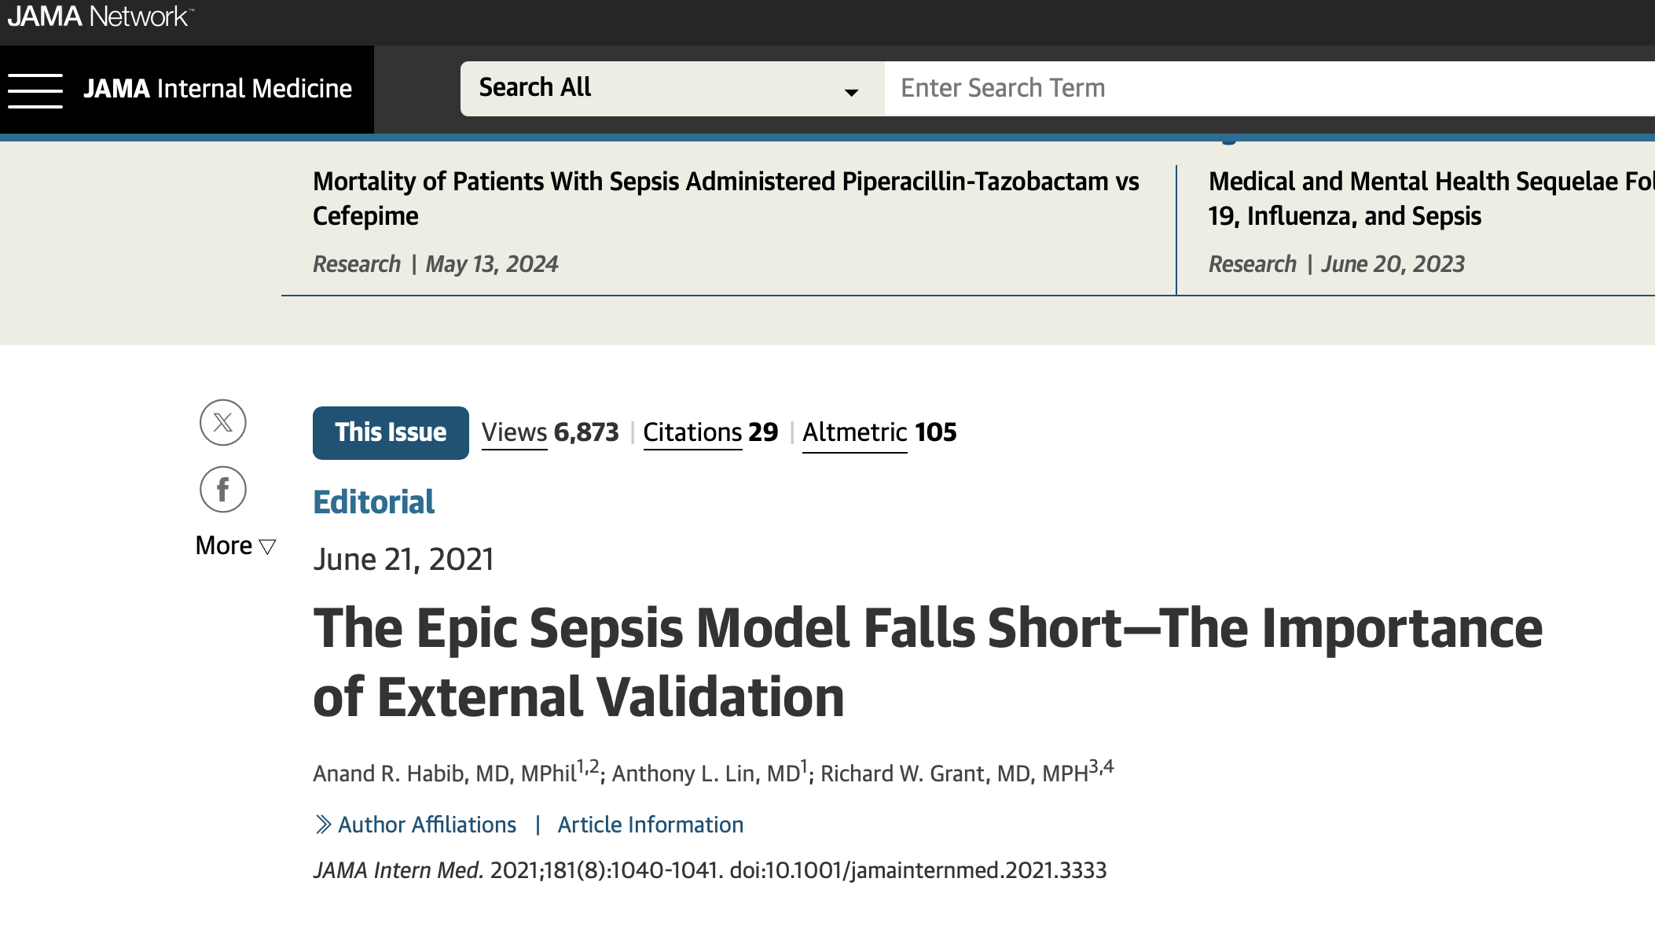

Robust evaluation of the models
When a model is designed for an environment, validation within that environment requires careful thought to ensure that no unintended label leakage has occurred between the datasets used for model tuning and independent testing.
Example:

Slide 13

Multi-source data
Harmonising the data and investigating different sources of noise, potential errors, and inconsistencies are important.
If different devices are used to collect the data, you need to consider solutions to reduce the effect of calibration and measurement errors and variations.
You need to investigate the protocols and procedures used in each site to collect the data to ensure the data is consistent.
For more information, please refer to Alexander Capstick’s work on the LAP model:
https://github.com/alexcapstick/LossAdaptedPlasticity
https://arxiv.org/abs/2212.02895

Slide 14
Ethical implications - bias
Several works have identified ways in which non-health-related ML can exacerbate existing social inequalities by reflecting and amplifying existing race, sex and other biases.
Health care is not immune to bias.
The health data on which algorithms are trained are likely influenced by many facets of social inequality, including bias toward those who contribute the most data.
Source: Wiens, J., Saria, S., Sendak, M. et al. Do no harm: a roadmap for responsible machine learning for health care. Nat Med 25, 1337–1340 (2019).

Slide 15
Algorithmic bias
Algorithms that predict an individual’s risk for a condition or suitability of a specific treatment may be biased toward those who are able to access and afford the procedure.
This could happen by feeding data from the people who have had that treatment in the past, which won’t include people who couldn’t afford it in the first place or didn’t have access to it.
Some of this bias can be corrected during model training when the data is divided into training, validation and test sets.
In general, awareness is necessary to investigate when potential biases could be present in the data and what can be done to mitigate their effect.
Source: Wiens, J., Saria, S., Sendak, M. et al. Do no harm: a roadmap for responsible machine learning for health care. Nat Med 25, 1337–1340 (2019).

Slide 16

Robust evaluation of the models
When a model is designed for an environment, validation within that environment requires careful thought to ensure that no unintended label leakage has occurred between the datasets used for model tuning and independent testing.
For example, the ‘radiologist-level’ performance recently achieved across several tasks using chest X-rays. The data used in the analysis consisted of multiple X-ray images per patient. It was important to split data at the patient level instead of random splitting so that no images from the same patient appeared in both the training and testing sets.
Source: Wiens, J., Saria, S., Sendak, M. et al. Do no harm: a roadmap for responsible machine learning for health care. Nat Med 25, 1337–1340 (2019).

Slide 17

Importance of qualitative analysis
Beyond quantitative measures of performance, qualitative approaches can expose concerns associated with bias and confounding that the quantitative measures might have missed.
For example, clinical experts can investigate explanations provided at individual test points to determine whether the model is plausible and relevant.
Source: Wiens, J., Saria, S., Sendak, M. et al. Do no harm: a roadmap for responsible machine learning for health care. Nat Med 25, 1337–1340 (2019).

Slide 18
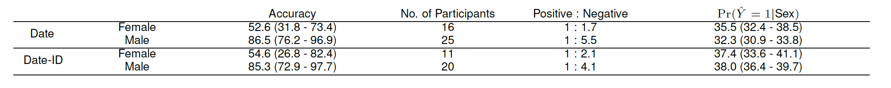
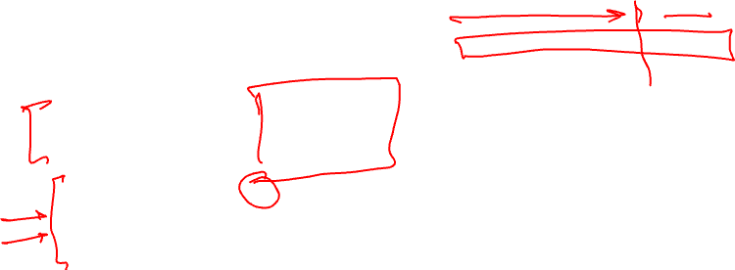
Ethical implications – Bias
The health data on which algorithms are trained are likely to be influenced by many facets of social inequality, including bias toward those who contribute the most data.
Example:
(Capstick et al., npj Dig. Med., 2024)
Source (bullet points): Wiens, J., Saria, S., Sendak, M. et al. Do no harm: a roadmap for responsible machine learning for health care. Nat Med 25, 1337–1340 (2019).

Slide 19

Reporting and context of the application
Proposed reporting guidelines developed by the community provide good ideas to outline the importance of clear descriptions of the source of the data, participants, outcomes and predictors, and in some cases, require the model itself (e.g., regression coefficients) to be presented.
This last requirement creates a potential for unintended consequences and even harm if the model is then applied inappropriately.
For example, a recent study in building models to predict healthcare-associated infections found that variables associated with risk at one hospital were protective in another.
So, it is essential to report the context(s) in which the model applies and was validated.
Source: Wiens, J., Saria, S., Sendak, M. et al. Do no harm: a roadmap for responsible machine learning for health care. Nat Med 25, 1337–1340 (2019).

Slide 20
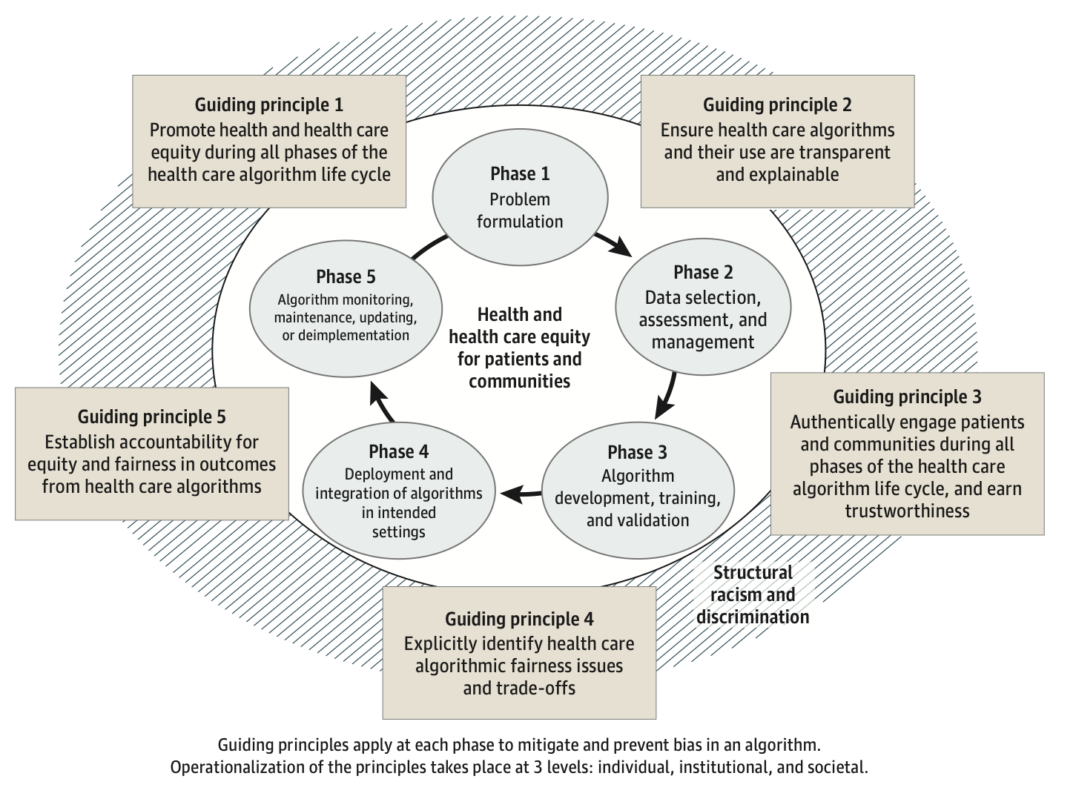

A conceptual framework
This conceptual framework builds on a US National Academy of Medicine algorithm life cycle framework adapted by Roski et al.
Source: Marshall H. Chin, et al., JAMA Network.

Slide 21
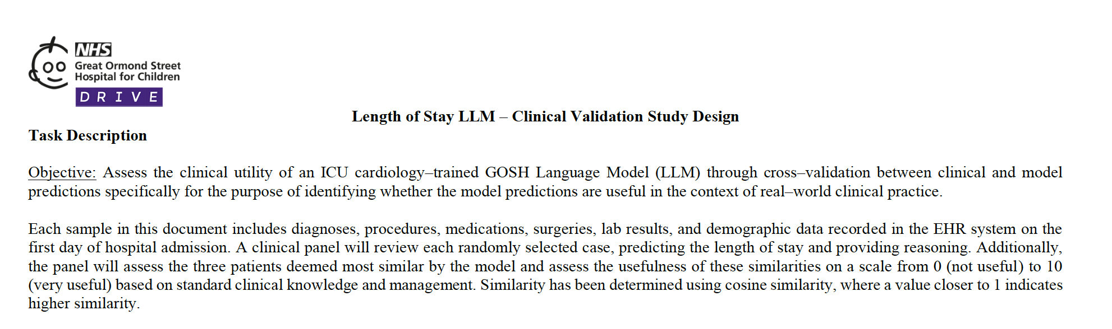

Importance of qualitative analysis
Beyond quantitative measures of performance, qualitative approaches can expose concerns associated with bias and confounding that the quantitative measures might have missed.
For example, clinical experts can investigate explanations provided at individual test points to determine whether the model is plausible and relevant.
Example:
Source (bullet points) : Wiens, J., Saria, S., Sendak, M. et al. Do no harm: a roadmap for responsible machine learning for health care. Nat Med 25, 1337–1340 (2019).

Slide 22
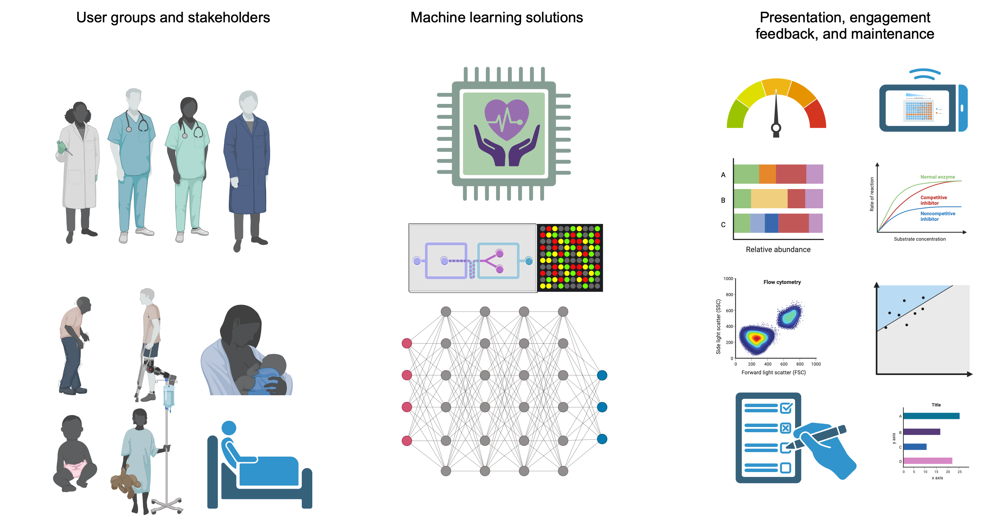

User perception and training requirements
Created with BioRender.com

Slide 23

Deployment and maintenance responsibility
Effectively applying a predictive model in an ethical, legal and morally responsible manner within a real-world healthcare setting can be substantially more difficult than developing a model in a curated experimental environment.
Before integrating an AI/ML model into patient care, it is critical to test the system in ‘silent’ mode, in which predictions are made in real-time and exposed to a group of clinical experts but not acted upon.
This prospective validation allows clinicians to identify and review errors in real-world settings.
Source: Wiens, J., Saria, S., Sendak, M. et al. Do no harm: a roadmap for responsible machine learning for health care. Nat Med 25, 1337–1340 (2019).

Slide 24
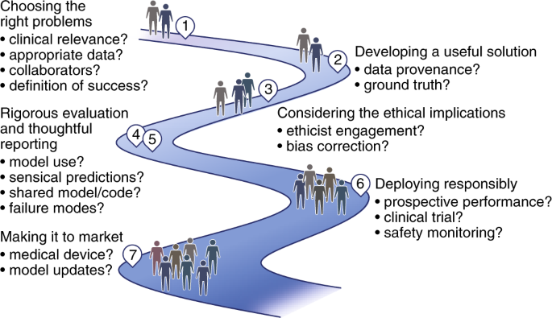

A roadmap for deploying effective ML systems
Source: Wiens, J., Saria, S., Sendak, M. et al. Do no harm: a roadmap for responsible machine learning for health care. Nat Med 25, 1337–1340 (2019).

Slide 25
Explainability of the models
Providing an explanation of the decision-making process in ML models is important to make them more interpretable.
For example, providing feature importance/contributions in the predictions helps to provide more explanation to the decision-making/prediction process of the model.
In recent years, methods such as SHAP graphs, highlights in imaging or heatmaps have been used to add more explainability to the models.
However, evaluating the explainability of the models should not be limited to presenting them. Further investigation and clinical/care expert knowledge and analysis should be sought for the provided explanations.

Slide 26

Explaining what and to whom
For example, in some models designed for medical imaging, a heatmap or a region highlight is used to show the area that the model has been looking for to obtain the results/predictions.
“However, the important question for users trying to understand an individual decision is not where the model was looking but instead whether it was reasonable that the model was looking in this region” [1].
A good article on this topic:
[1] Ghassemi M, Oakden-Rayner L, Beam AL. The false hope of current approaches to explainable artificial intelligence in health care. Lancet Digit Health. 2021 Nov;3(11):e745-e750. doi: 10.1016/S2589-7500(21)00208-9. PMID: 34711379.

Slide 27
Privacy issues
Methods such as imputation and predictive analysis could reveal information about participants that they have declared to provide.
For example, a data imputation method could provide an estimate for a variable (e.g. alcohol consumption) that they had declined to provide.
Or narrowing down the analysis to a small sub-group in a dataset is not handled carefully and could risk making the participants identifiable.

Slide 28
Fairness and imbalance
Analysing the outcomes and actions driven by the designed methods could help investigate whether data or sampling issues have led to biased decisions.
Predictions and decisions should also be investigated for potential disparity across different demographics and groups.
The training data should be investigated for unfair bias or imbalance.

Slide 29
Evaluation metrics
Appropriate evaluation metrics and suitable/applicable targets for the intended outcomes should be considered.
For example, what time window would be suitable for the input data to make a prediction, and what are the acceptable sensitivity and specificity thresholds for the intended applications?
In some applications, specificity and sensitivity or precision/recall may not carry the same weight, so the methods that look for an optimum balance between the two measures will not be suitable for this type of application.
For example, a screening test may require higher recall, but lower precision could be tolerated.

Slide 30
Prediction and analysis errors
In real-world deployments, you may need to identify suitable channels and procedures to investigate/report the prediction errors.
Identifying procedures and steps to re-train/adjust the model to avoid potentially harmful errors.
However, this should be done carefully and not add further inconsistencies or potential bias/errors to the model.

Slide 31

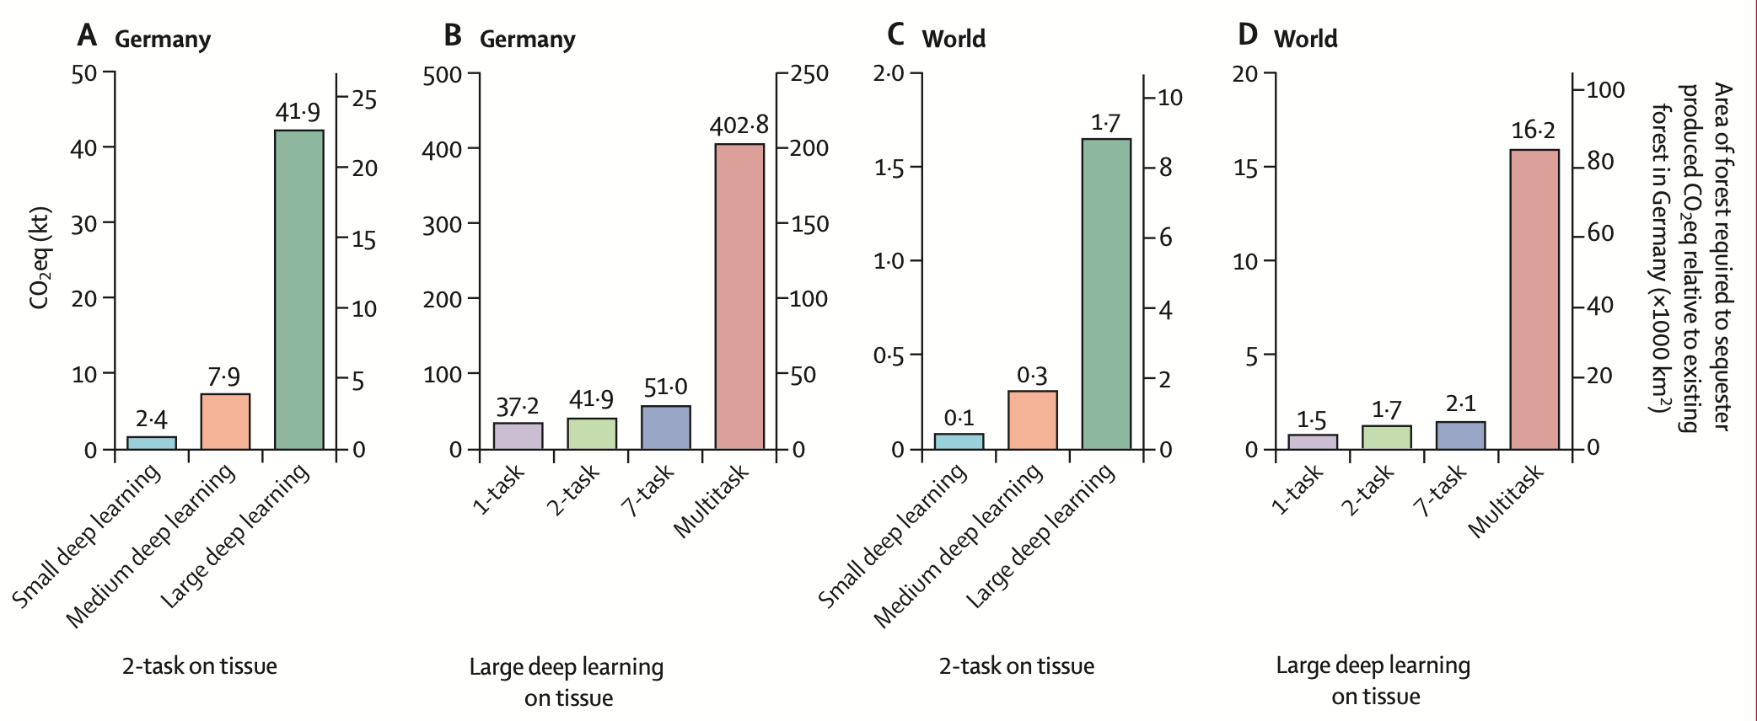
Sustainability and Environmental Impact
Vafaei Sadr, Alireza et al., Operational greenhouse-gas emissions of deep learning in digital pathology: a modelling study, The Lancet Digital Health, Dec 2023.

Slide 32

Reporting the results
In the following slides, some of the good practices for reporting the results of machine learning models are discussed.
I have used examples from our recent paper on UTI risk analysis in people living with dementia using remote monitoring data (A. Capstick et al., npj digital medicine, 2024, https://www.nature.com/articles/s41746-023-00995-5).
The evaluations are based on ID and ID-Date splits
In the ID split, the test data includes data from patients that the model has never seen before.
In the ID-Date split, the test data include data from a period of time and from patients that the model has not seen before.

Slide 33
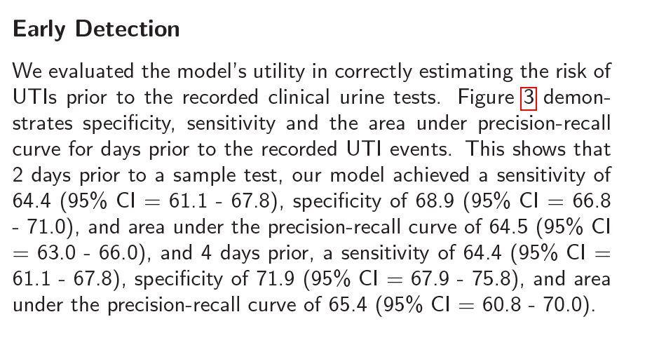
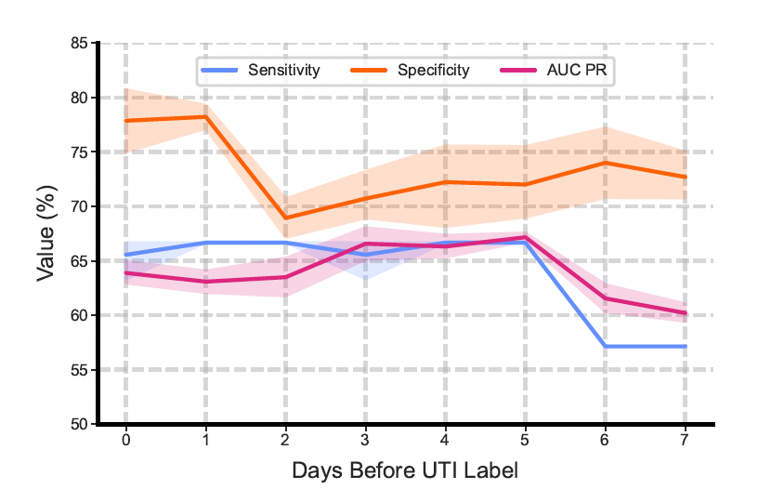
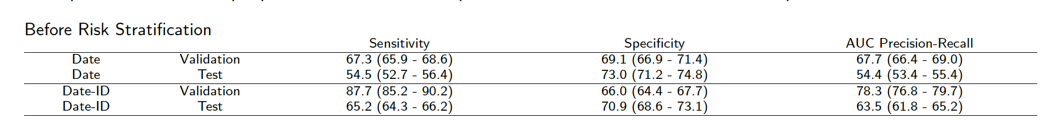

Report variations in the experiments
Examples:
Source: A. Capstick et al., npj digital medicine, 2024, https://www.nature.com/articles/s41746-023-00995-5

Slide 34
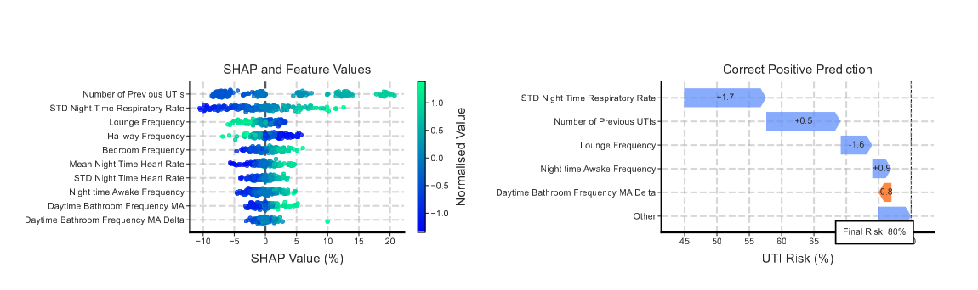

Show feature importance (if you can)
Source: A. Capstick et al., npj digital medicine, 2024, https://www.nature.com/articles/s41746-023-00995-5

Slide 35
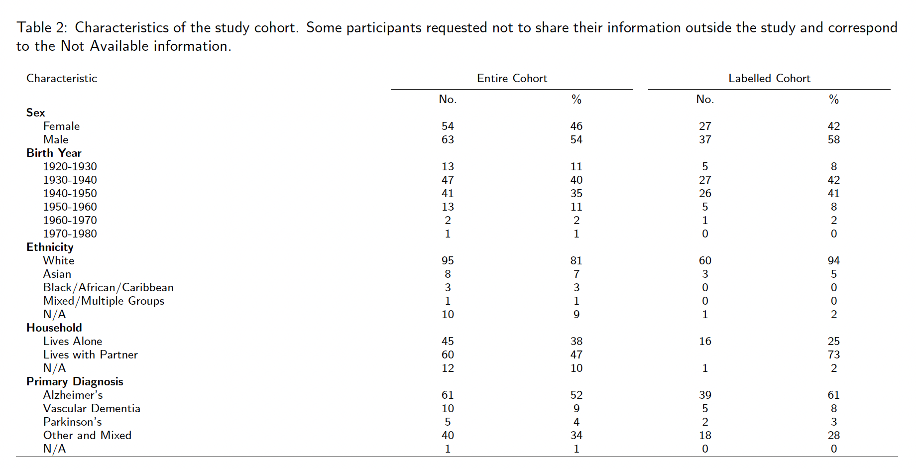
Report the demographics and other data characteristics
Source: A. Capstick et al., npj digital medicine, 2024, https://www.nature.com/articles/s41746-023-00995-5

Slide 36
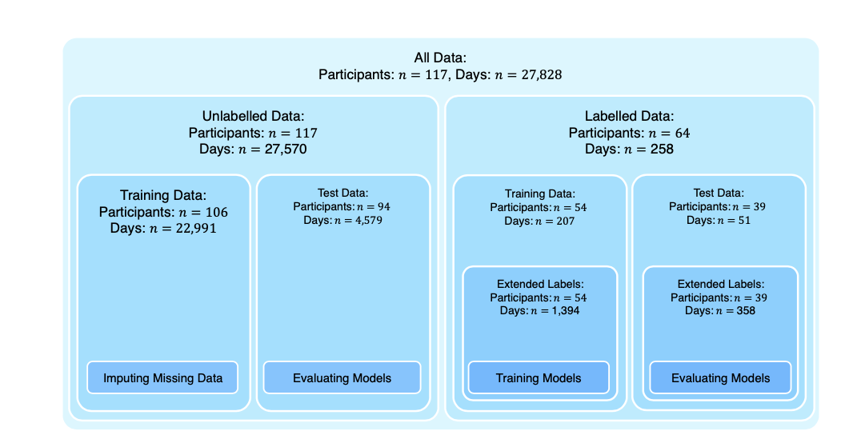
Report training/test splits
Source: A. Capstick et al., npj digital medicine, 2024, https://www.nature.com/articles/s41746-023-00995-5

Slide 37
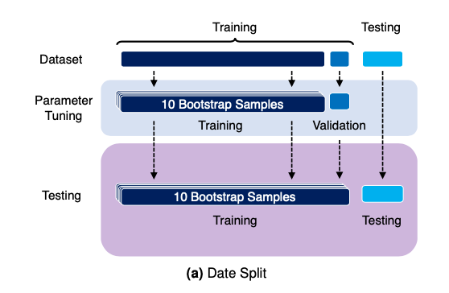
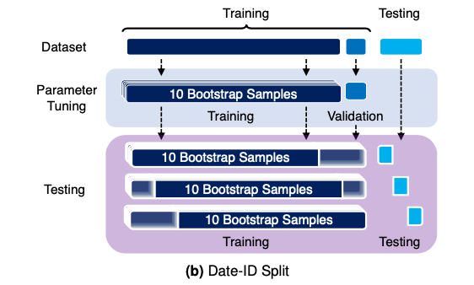
Report validation and repeats
Source: A. Capstick et al., npj digital medicine, 2024, https://www.nature.com/articles/s41746-023-00995-5

Slide 38
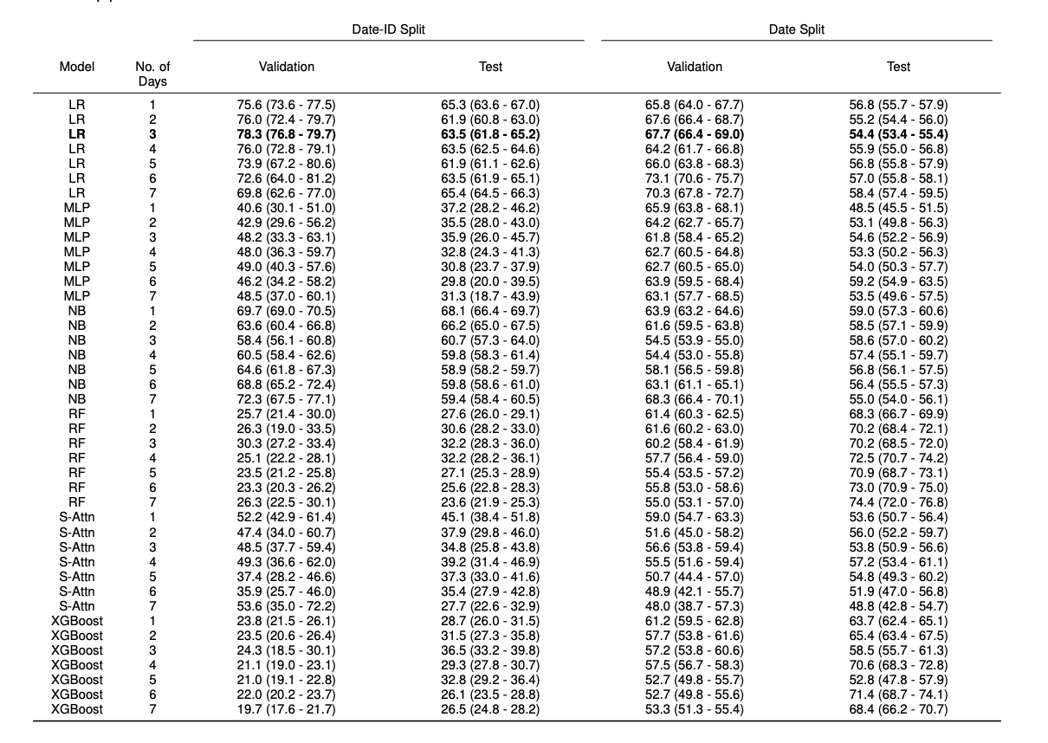
Report comparisons against baseline models
Source: A. Capstick et al., npj digital medicine, 2024, https://www.nature.com/articles/s41746-023-00995-5

Slide 39
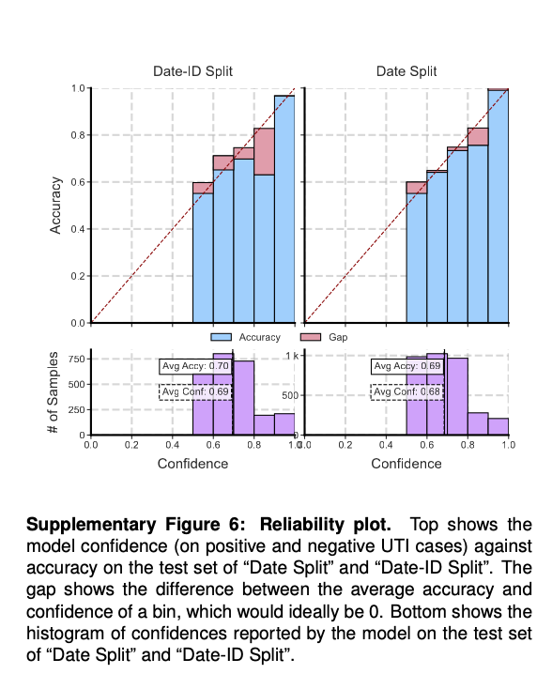

Analyse reliability of your model
Source: A. Capstick et al., npj digital medicine, 2024, https://www.nature.com/articles/s41746-023-00995-5

Slide 40
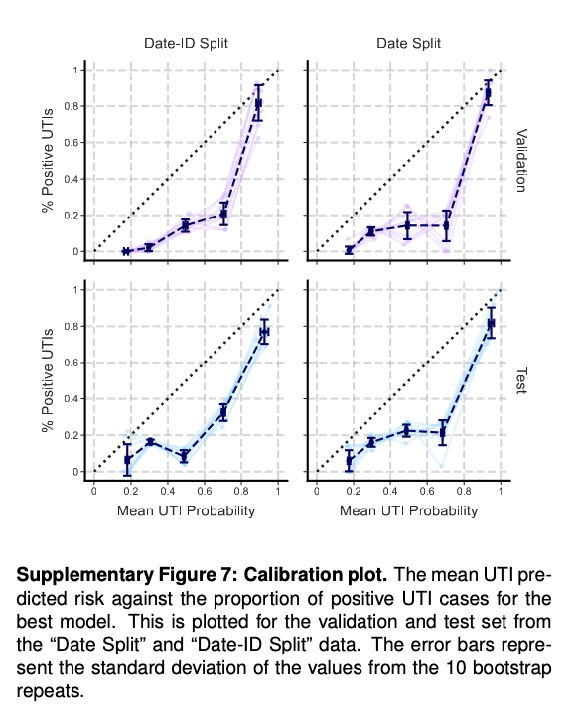
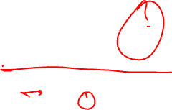
Investigate calibration
Source: A. Capstick et al., npj digital medicine, 2024, https://www.nature.com/articles/s41746-023-00995-5

Slide 41
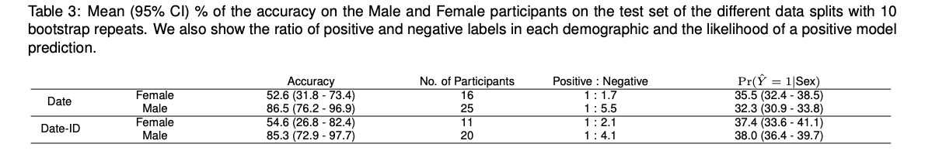

Investigate for bias
Source: A. Capstick et al., npj digital medicine, 2024, https://www.nature.com/articles/s41746-023-00995-5

Slide 42
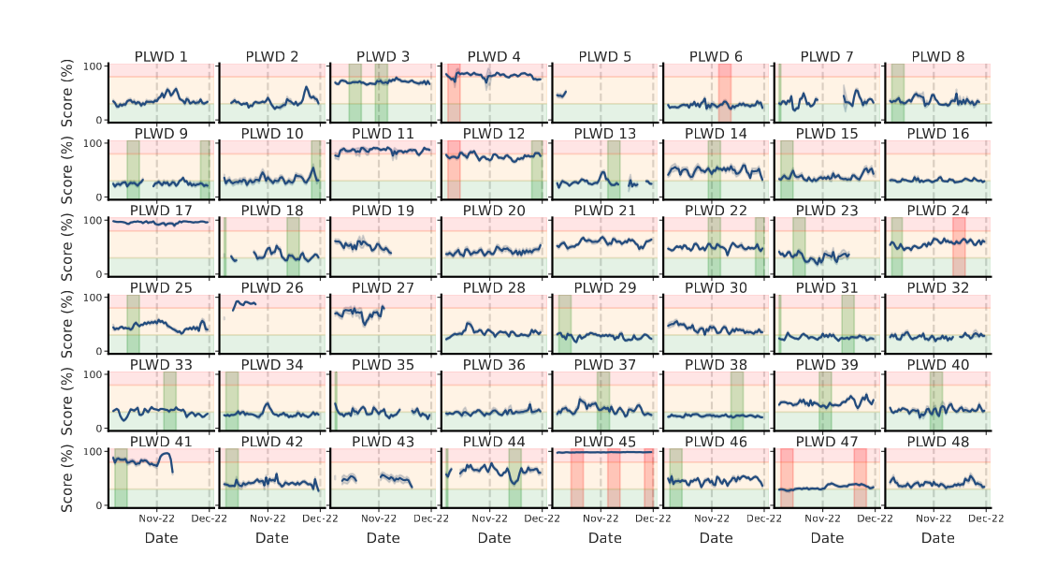

Decision-support vs. current practice
Source: A. Capstick et al., npj digital medicine, 2024, https://www.nature.com/articles/s41746-023-00995-5

Slide 43

Important notes in reporting
Discuss ethical considerations and potential risks
Learn about clinical context and use (needs to start before technical development); for example, UTIs are recurrent, and a person with a past history of UTI could have a higher risk of having another UTI.
Report ethical approvals and regulatory requirements/approvals (if applicable)
Describe data availability
Capture and report code, libraries used and versions (or create a reproducible environment)
Report any pre-processing, imputation, scaling and normalisation
Report libraries and hyperparameters
Avoid any leap of magic!

Slide 44

Responsible and ethical machine learning
Anticipate risks and potential issues
Actively engage and think of solutions
Work with domain experts and learn about the context and conditions of data collection, and the use of system/model.
Create feedback loops (before and after deployment)
Plan for update and maintenance

Slide 45

Responsible and ethical machine learning
Consider all issues, including bias, fairness, and the risk of harm, throughout your design, development, evaluation, and deployment.
Consider sustainability requirements and scaling/generalisation.
Considering these requirements is not somebody else’s responsibility but the ML model designers'.

Slide 46

Regulatory framework and existing guidelines
In designing and deploying ML models for healthcare and medical applications, you need to investigate the regulatory requirements.
e.g., UKCA (UK), CE (Europe), FDA (USA) requirements and medical device registration.
The existing guidelines for treatment and interventions. For example, the NICE guidelines: https://www.nice.org.uk/guidance
EU Regulatory framework proposal on Artificial Intelligence, https://digital-strategy.ec.europa.eu/en/policies/regulatory-framework-ai

Slide 47
Further reading
A good article on this topic:
Wiens, J., Saria, S., Sendak, M. et al. Do no harm: a roadmap for responsible machine learning for health care. Nat Med 25, 1337–1340 (2019). https://doi.org/10.1038/s41591-019-0548-6

Slide 48
If you have any questions
Please feel free to arrange a meeting or email (p.barnaghi@imperial.ac.uk).
My office: 928, Sir Michael Uren Research Hub, White City Campus.

